Slide 1
Interface in Java
Presented by S.R.Zameer

Slide 2
Interface in Java
An interface in java is a blueprint of a class. It has static constants and abstract methods only.
The interface in java is a mechanism to achieve fully abstraction. There can be only abstract methods in the java interface not method body. It is used to achieve fully abstraction and multiple inheritance in Java.
Java Interface also represents IS-A relationship.
It cannot be instantiated just like abstract class.

Slide 3
Why use Java interface?
There are mainly three reasons to use interface. They are given below.
It is used to achieve fully abstraction.
By interface, we can support the functionality of multiple inheritance.
It can be used to achieve loose coupling.

Slide 4
The java compiler adds public and abstract keywords before the interface method and public, static and final keywords before data members.
In other words, Interface fields are public, static and final by default, and methods are public and abstract.

Slide 5
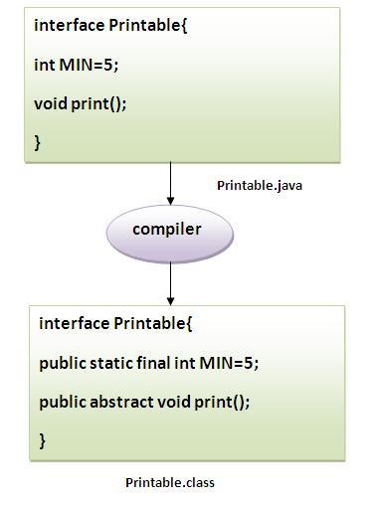
Example

Slide 6
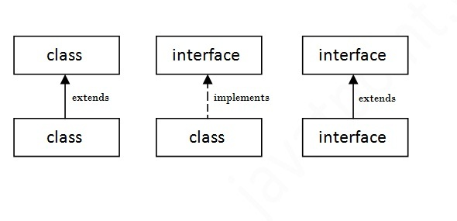
Understanding relationship between classes and interfaces

Slide 7
Simple example of Java interface
In this example, Printable interface have only one method, its implementation is provided in the A class.
interface printable{
void print();
}
class A6 implements printable{
public void print(){System.out.println("Hello");}
public static void main(String args[]){
A6 obj = new A6();
obj.print();
}
}
Output: Hello.

Slide 8
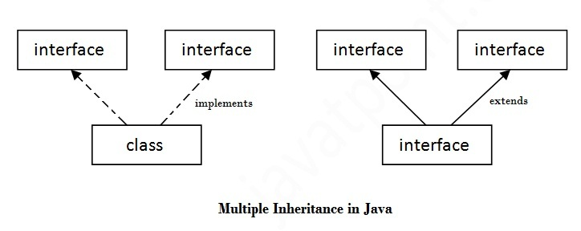
Multiple inheritance in Java by interface
If a class implements multiple interfaces, or an interface extends multiple interfaces i.e. known as multiple inheritance.

Slide 9
Example
interface Printable{
void print();
}
interface Showable{
void show();
}
class A7 implements Printable,Showable{
public void print(){System.out.println("Hello");}
public void show(){System.out.println("Welcome");}
public static void main(String args[]){
A7 obj = new A7();
obj.print();
obj.show();
}
}
Output: Hello
Welcome

Slide 10
Q) Multiple inheritance is not supported through class in java but it is possible by interface, why?
As we have explained in the inheritance chapter, multiple inheritance is not supported in case of class. But it is supported in case of interface because there is no ambiguity as implementation is provided by the implementation class.

Slide 11
Example
interface Printable{
void print();
}
interface Showable{
void print();
}
class TestTnterface1 implements Printable,Showable{
public void print(){System.out.println("Hello");}
public static void main(String args[]){
TestTnterface1 obj = new TestTnterface1();
obj.print();
}
}
Output: Hello.
in the above example, Printable and Showable interface have same methods but its implementation is provided by class TestTnterface1, so there is no ambiguity.

Slide 12
Interface inheritance
A class implements interface but one interface extends another interface .
interface Printable{
void print();
}
interface Showable extends Printable{
void show();
}
class Testinterface2 implements Showable{
public void print(){System.out.println("Hello");}
public void show(){System.out.println("Welcome");}
public static void main(String args[]){
Testinterface2 obj = new Testinterface2();
obj.print();
obj.show();
}
}
Output:
Hello
Welcome

Slide 13
Nested Interface in Java
Note: An interface can have another interface i.e. known as nested interface. We will learn it in detail in the nested classes chapter. For example:
interface printable{
void print();
interface MessagePrintable{
void msg();
}
}

